Slide 1





CIFAR-10 Image Classification Using Convolutional Neural Networks
A Deep Learning pipeline implementation using TensorFlow & Keras for multi-class image recognition and model evaluation.
Project Team Members Department of AI & Data Science | Date: 31.08.2026
Department of AI & Data Science | Date: 31.08.2026
ABINAND CV
AKARSH PREM
ANNLIA JISHA RAJEEV
VML24AD006
VML24AD014
VML24AD031
DENZ JOSEPH
JISTO JOSE
SHRIYA SREEJEESH
VML24AD044
VML24AD065
VML24AD108

Slide 2




Project Objective
Primary Goals
Evaluation & Experimentation
Develop a robust Convolutional Neural Network (CNN) model to automatically categorize RGB color images.
Monitor training and validation metrics across 20 training epochs.
Evaluate overall performance using Categorical Crossentropy Loss and Test Accuracy.
Classify test images into 10 distinct object categories from the benchmark CIFAR-10 dataset.
Generate a 10x10 Confusion Matrix to analyze actual vs. predicted class distributions.
Implement an end-to-end Machine Learning pipeline in Python using TensorFlow and Keras.
Compute comprehensive class-wise Precision, Recall, and F1-Scores.
Perform data preprocessing including pixel normalization and label categorical encoding.
Conduct experimental trial with Data Augmentation to study generalization impact.
Key Outcome: Achieving automated visual feature extraction without manual feature engineering.
Comparative Study: Benchmark Basic CNN against Augmented CNN architecture.

Slide 3
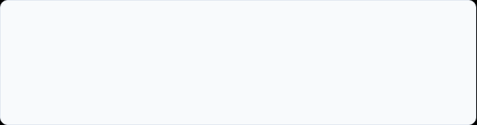














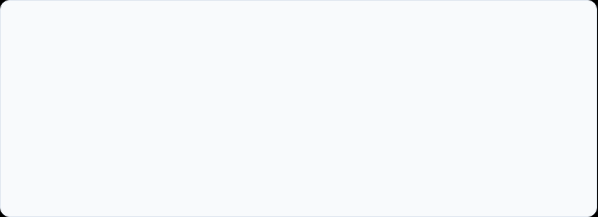

Dataset & Preprocessing
Dataset Statistics
10 Target Classes
50K
10K
32×32
TRAIN SAMPLES
TEST SAMPLES
3-CHANNEL RGB
Preprocessing Workflow
Pixel Normalization: Scaled pixel color intensities from range [0, 255] down to float values [0.0, 1.0] via division by 255.0 to accelerate convergence.
Label Encoding: Converted 1D integer class targets (shape: 50000, 1) into 10D One-Hot Encoded vectors (shape: 50000, 10) using to_categorical().
Representative 32x32 color samples from CIFAR-10 benchmark dataset

Slide 4

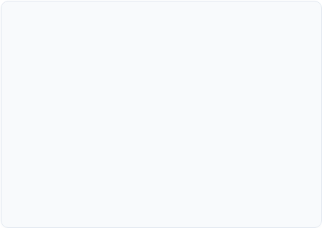
CNN Model Architecture
Input
Shape: (32, 32, 3) RGB Image
0 Params
Conv2D_1
32 Filters (3x3), ReLU Activation
896 Params
122,570
MaxPool_1
Pool Size (2,2) → Output (15, 15, 32) + Dropout (25%)
0 Params
Conv2D_2
TOTAL TRAINABLE PARAMETERS
64 Filters (3x3), ReLU Activation
18,496 Params
Model Memory Footprint: ~478.79 KB
MaxPool_2
Pool Size (2,2) → Output (6, 6, 64) + Dropout (25%)
0 Params
Conv2D_3
64 Filters (3x3), ReLU Activation → Output (4, 4, 64)
36,928 Params
Key Design Principles
Feature Learning: Progressive filter growth (32 → 64 → 64) captures low to high-level visual features.
Flatten
Feature Map Vectorization → 1,024 Neurons
0 Params
Dense_1
64 FC Neurons, ReLU Activation + Dropout (50%)
65,600 Params
Regularization: Strategic Dropout layers (25% post-pooling, 50% post-dense) reduce overfitting risk.
Output
10 Neurons, Softmax Activation
650 Params
Dimension Reduction: Max-pooling reduces spatial dimensions while preserving dominant feature maps.

Slide 5

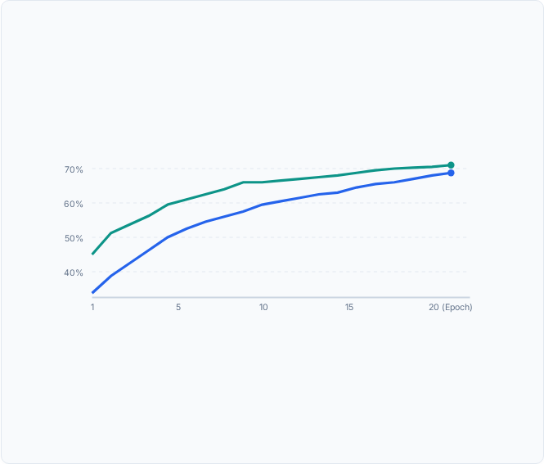

Model Training Progression
Training Setup
Accuracy Trajectory (Notebook Plot)
Optimizer | Adam
Loss Function | Categorical Crossentropy
Batch Size | 64
Validation Split | 20% (10,000 samples)
Epochs Trained | 20 Epochs
Key Training Milestones
Epoch 1: Val Accuracy = 46.96% | Val Loss = 1.4673
Epoch 10: Val Accuracy = 67.09% | Val Loss = 0.9335
Epoch 20 (Final): • Val Accuracy: 71.05% • Training Accuracy: 68.31% • Validation Loss: 0.8353
Training Accuracy (68.31%) Validation Accuracy (71.05%)

Slide 6







Basic CNN Performance
70.11%
0.8563
0.70
10,000
TEST ACCURACY
TEST LOSS
MACRO F1-SCORE
TEST IMAGES
Class-Wise Classification Report
High Performing Classes
Class Name | Precision | Recall | F1-Score
Automobile | 0.88 | 0.82 | 0.85
Truck | 0.82 | 0.81 | 0.82
Ship | 0.78 | 0.85 | 0.81
Frog | 0.71 | 0.81 | 0.76
Horse | 0.78 | 0.72 | 0.75
Airplane | 0.78 | 0.68 | 0.73
Deer | 0.62 | 0.69 | 0.65
Dog | 0.66 | 0.54 | 0.59
Bird | 0.50 | 0.64 | 0.56
Cat | 0.54 | 0.46 | 0.50
Vehicles (Automobile, Truck, Ship): Distinct geometric edges and linear shapes enable high precision (>80%).
Challenging Classes
Animals (Cat, Bird, Dog): High intra-class variance and background ambiguity lead to lower F1-scores (0.50 - 0.59).

Slide 7








Confusion Matrix & Predictions
Misclassification Insights
Sample Prediction Outcomes
Cat vs. Dog Confusion: 140 Actual Cats misclassified as Dogs; 180 Actual Dogs misclassified as Cats due to shared body structures.
Cat vs. Bird / Frog: 151 Cat images predicted as Birds, 104 as Frogs due to low-resolution texture overlaps.
High Vehicle Accuracy: • 852 / 1000 Ships correctly predicted. • 819 / 1000 Automobiles correctly predicted. • 813 / 1000 Trucks correctly predicted.
CORRECT PREDICTIONS
INCORRECT PREDICTIONS
• Actual: Cat → Pred: Cat
• Actual: Airplane → Pred: Deer
• Actual: Ship → Pred: Ship
• Actual: Dog → Pred: Deer
Key Takeaway: Model excels at structural object recognition but struggles with fine-grained animal features at 32x32 resolution.
• Actual: Frog → Pred: Frog
• Actual: Dog → Pred: Cat
CONFUSION MATRIX HIGHLIGHTS (SAMPLE COUNT)

Slide 8


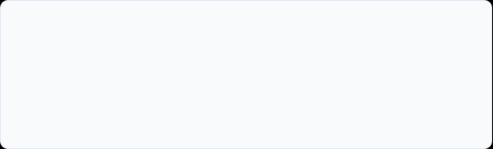

Data Augmentation Trial
Augmentation Parameters (`ImageDataGenerator`)
Augmented Image Transformations
Rotation Range | ±15 Degrees
Width Shift Range | 10% (0.1)
Height Shift Range | 10% (0.1)
Horizontal Flip | True (Enabled)
Fill Mode | Nearest Neighbor
Visual transformations generated from training batch samples (rotations, shifts, flips):
15° Rotation
Width Shift
Horiz Flip
Experimental Setup
Trained a second model (model_aug) with identical CNN architecture (122,570 parameters).
Generated transformed images dynamically on-the-fly using datagen.flow().
Trained for 20 Epochs with batch size of 64 using Adam optimizer.
Goal: Evaluate if artificial variance improves generalization on unseen test samples without changing model capacity.

Slide 9
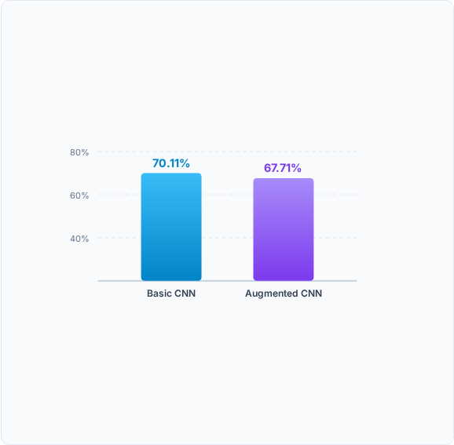

Basic CNN vs Augmented CNN
Performance Comparison Table
Test Accuracy Visual Comparison
Model Variant | Test Loss | Test Accuracy
Basic CNN | 0.8563 | 70.11%
CNN + Data Augmentation | 0.9231 | 67.71%
Difference (Delta) | +0.0668 | -2.40%
Experimental Observation:
The basic CNN performed better by approximately 2.40 percentage points in this specific 20-epoch experiment.
Note: Data augmentation requires longer training epochs to fully converge under heavier regularization.

Slide 10


Conclusion & Future Work
Project Key Findings
Future Improvements
Successfully built an end-to-end TensorFlow/Keras pipeline for 10-class image classification.
Architecture: Add Batch Normalization layers and evaluate deeper Residual Networks (ResNet / MobileNet).
The Basic 3-Block CNN achieved a strong 70.11% Test Accuracy (0.8563 Loss) on 10,000 unseen test samples.
Optimization: Implement Learning Rate Decay (Cosine Annealing) & automated hyperparameter tuning.
Vehicle categories (Automobile, Ship, Truck) demonstrated highest classification precision (>80%).
Augmentation: Fine-tune transformation ranges and train for longer epochs (50–100 epochs).
Data augmentation trial (67.71% accuracy) produced lower accuracy within 20 epochs under current capacity.
Transfer Learning: Leverage pre-trained ImageNet weights to boost accuracy above 90%.
"The project demonstrates a complete image-classification pipeline from preprocessing and CNN training to evaluation and experimentation."

